Slide 1
Demo Background
Deploy an e-commerce application on containers in a multi-region setup using Azure DevOps
Components of the application include but not limited to :
Azure Cosmos DB
Azure Kubernetes Service (AKS)
Azure Service Bus
Azure Redis
Azure Monitor
Azure Key Vault
The demo will leverage Azure DevOps to build and deploy the e-commerce application
During the demo we will simulate a region failure and showcase high availability of the deployed application. Since the application is multi-regional ; a region failure will have no effect on it’s availability

Slide 2
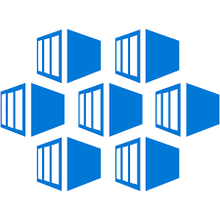
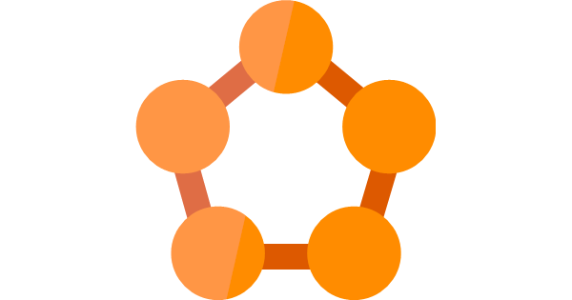


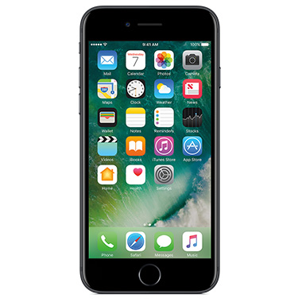
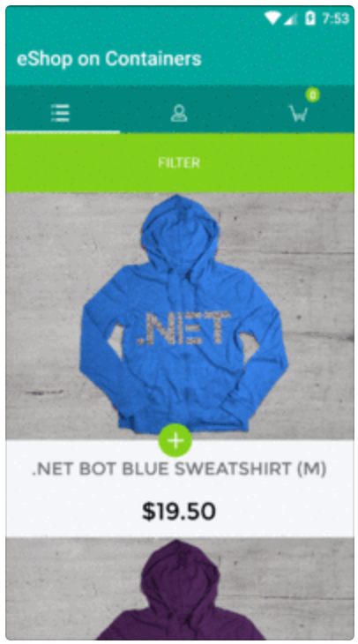
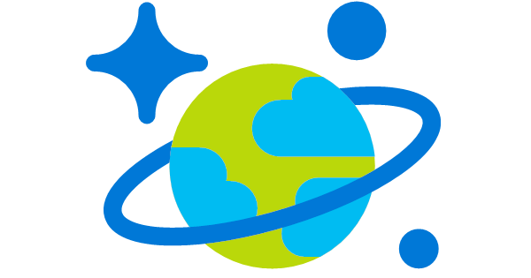
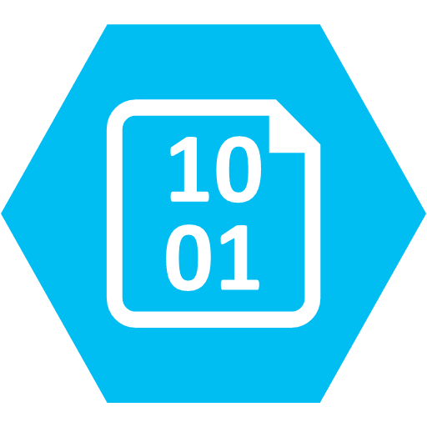
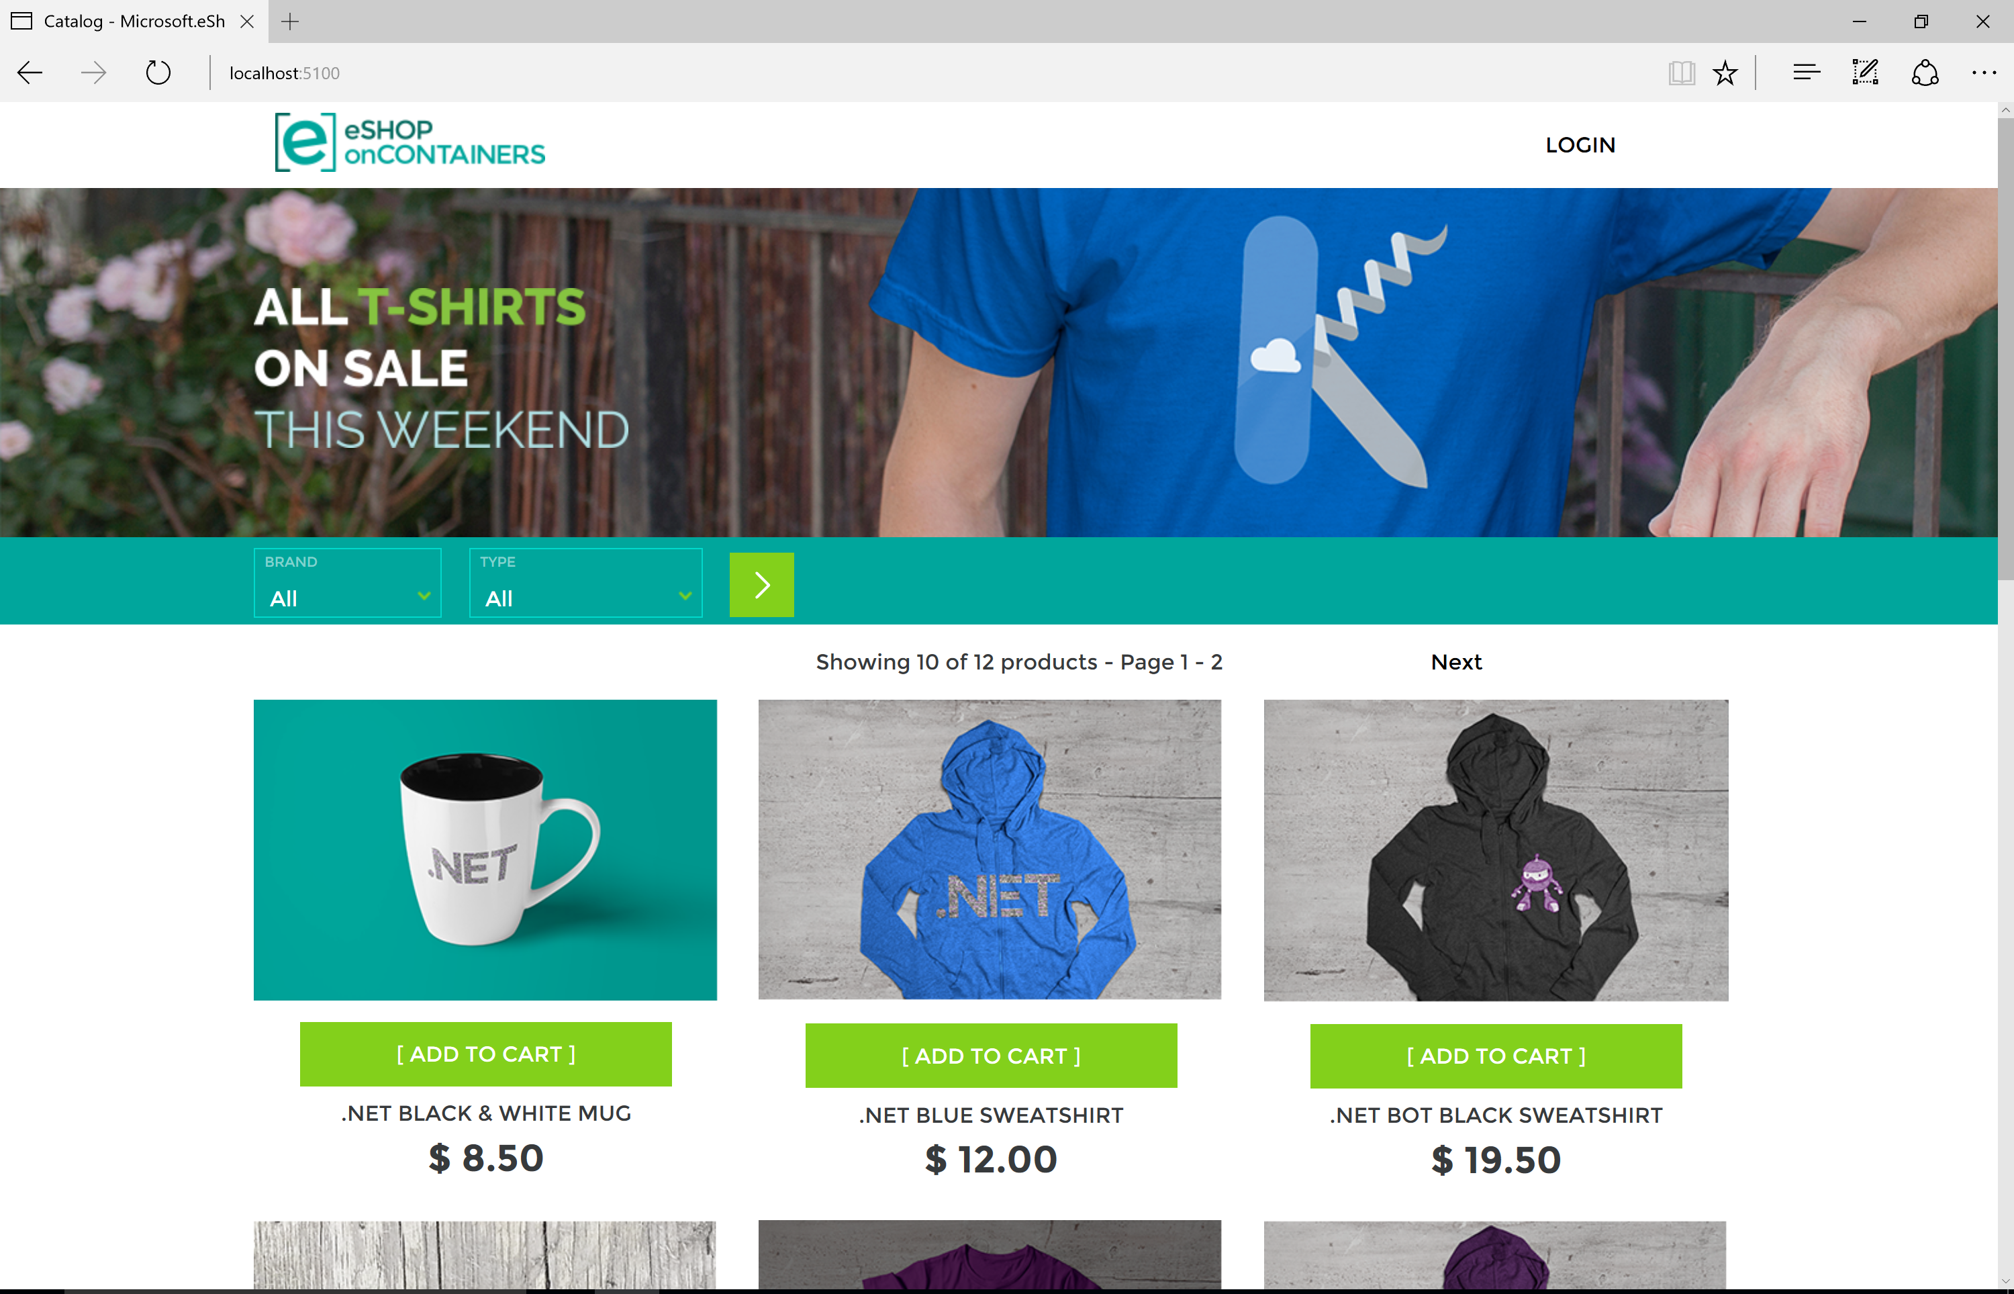


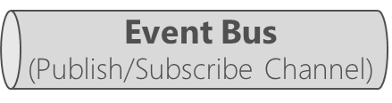
eShopOnContainers → in Azure
Client apps
Orchestrator in Azure
Identity microservice
(STS+users)
Azure – High Available application infrastructure as PaaS cloud
Azure Kubernetes Service (AKS)
Azure SQL Database
Azure Redis
eShop mobile app
or
Xamarin.Forms
C#
xPlat. OS:
iOS
Android
Windows
Azure Service Fabric
API Gateways/BFF
Catalog microservice
(Basket)
Mobile-Shopping
Ordering microservice
Azure Cosmos DB
Azure Storage - Blobs
Ordering.API
(Product
Images)
SignalR Hub
eShop traditional Web app
Mobile-Marketing
Ordering.BackgroundTasks
eShop WebApp MVC
Basket microservice
ASP.NET Core MVC
Other Azure infrastructure
HTML
Web-Shopping
Marketing microservice
Azure Container Registry
Azure Container Build
Application Insights
Azure Key Vault
Azure API Management
Azure Application Gateway
Azure Dev Spaces
…
eShop SPA Web app
Azure
Service Bus
Locations microservice
Web-Marketing
TypeScript/Angular

Slide 3
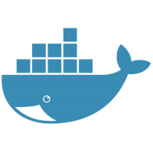


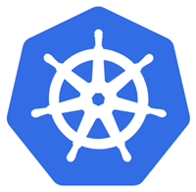









Orchestrator’s Cluster managing microservices/containers
App 1
App 2
My Docker Images
Clusters provide:
High scalability
Automatic High Availability and resiliency
High services density per host
My ASP.NET Core Services
For example:
Official Docker Images
Kubernetes
https://hub.docker.com
Service Fabric
Cluster of
Nodes/Hosts
VM
or
Notes:
For each service instance you use one container
Docker images/containers are “units of deployment”
A container is an instance of a Docker Image
A host (VM/server) handles many containers

Slide 4






Dev environment
Production environment
Customized
eShopOnContainers on Azure
Foundational
Development technologies
Cloud infrastructure and
Specific Orchestrators
.NET Core
ASP.NET Core
Azure Kubernetes Service (AKS)
Development
Orchestrators
+
Azure Service Fabric
Service Bus
SQL Database
Linux Containers
Windows Containers
Other Cloud
Infrastructure
Deployment
BLOB Storage
Cosmos DB
Redis Cache
Key Vault
Exploring Microservices
Architecture/Design/Development
Infrastructure
Decisions
Production-Ready Microservices

Slide 5
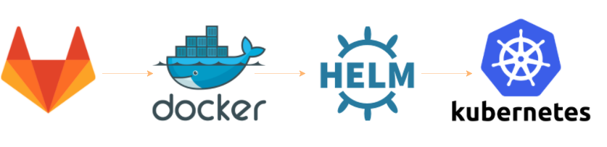
Kubernetes and Helm
Container
Images
Deploy
with
Orchestrator’s
cluster
Helm is THE package manager for Kubernetes:
…Kubernetes deployments with just Kubectl.exe and .yml files are not standard but custom & complex…
Helm improves:
Makes application deployment easy, standar and reusable
Easy application install, update, rollback & removal. Packages are declaratively defined in Helm Charts
Charts can be shared and publicly published (https://github.com/helm/charts/tree/master/stable)
Designed with versioning of packages in mind
You need Helm if you want to use Azure DevSpaces! :)
Notes:
https://docs.microsoft.com/en-us/azure/aks/kubernetes-helm#configure-helm
Sample:
INSTALL AN EXAMPLE CHART
To install a chart, you can run the helm install command. Helm has several ways to find and install a chart, but the easiest is to use one of the official stable charts.
$ helm repo update # Make sure we get the latest list of charts
$ helm install stable/mysql

Slide 6
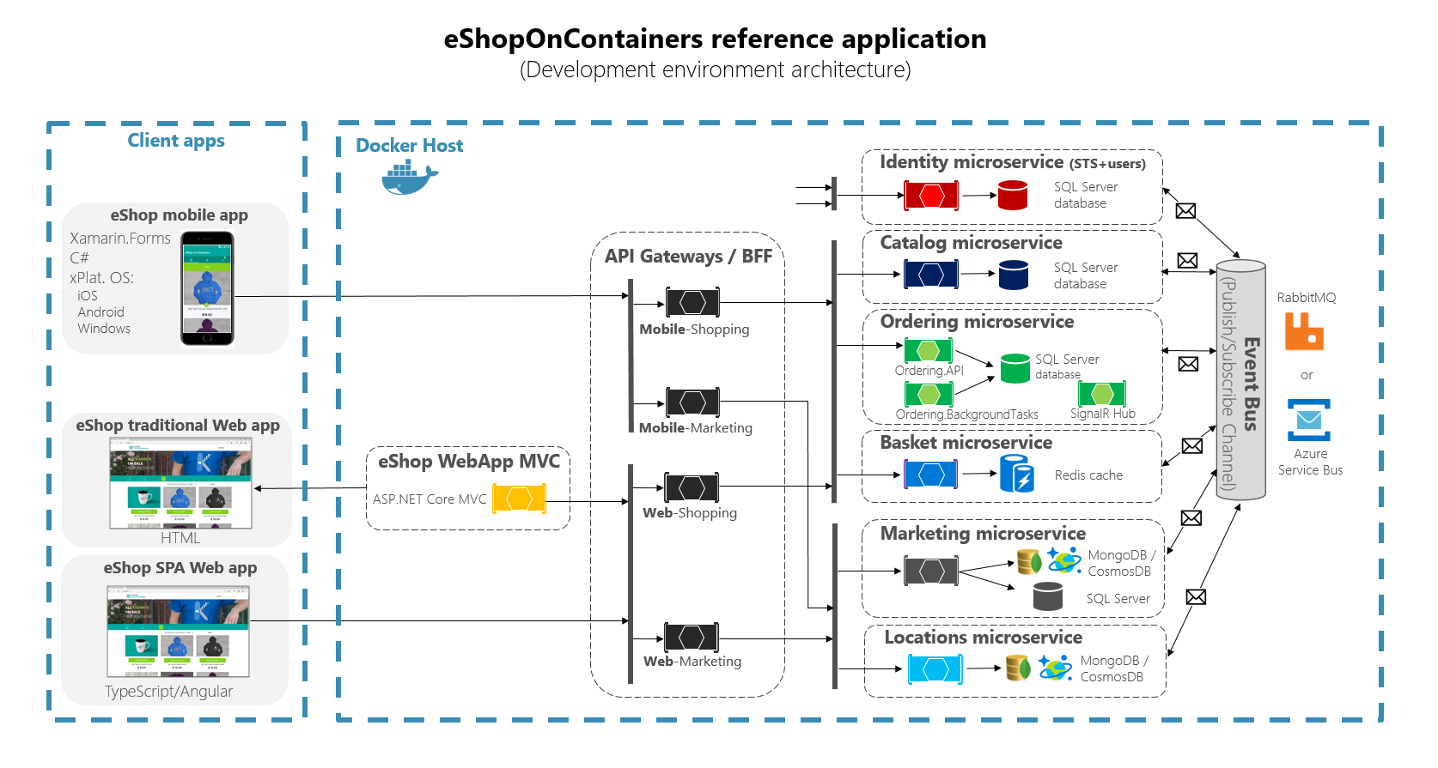
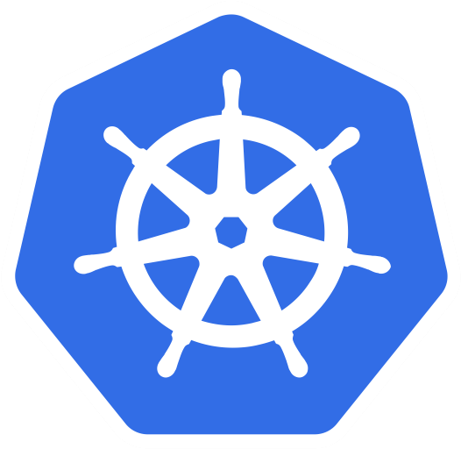
.NET Core 2.1
https://github.com/dotnet-architecture/eShopOnContainers
AKS

Slide 7
Demo Script
Notes:
Enable development on laptop
Show Build Pipeline
Sell doing a workshop with them
Speak about .NET core on containers
Implement a POC of this life cycle
Outcome: Should be to get a POC going using this stack and methodology. Pick an app to modernize on this stack.

Slide 8
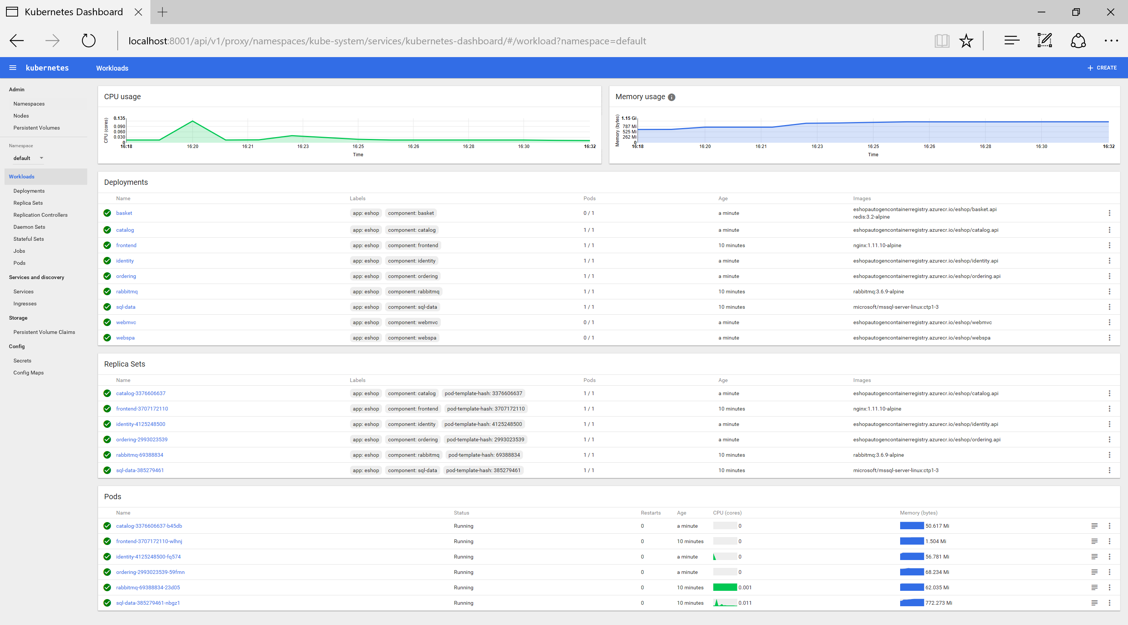
Demo 1
(5)
Notes:
Overview:
Azure portal AKS
Images in ACR
Kubernetes Dashboard
Deploy?
Scaling out

Slide 9
CI/CD pipelines with Docker containers and Azure

Slide 10

Lifecycle (Azure Dev Spaces)
Source control
CI/CD pipeline
helm upgrade—install
values.int.yaml
helm upgrade—install
values.prod.yaml
git commit
git push
Container registry
Lisa
namespace
Integration
namespace
Production
namespace
'up' or F5 debug
values.dev.yaml
Lisa
Dev Spaces enabled
Cesar
namespace
Cesar
Dev Spaces enabled
John
namespace
Dev Spaces enabled
John
Dev Spaces enabled
AKS cluster
Notes:
DEVELOPER EXPERIENCE
Run or debug code prior to commiting in a production-like development environment running in Azure
Work with real upstream and downstream dependencies instead of mocks or simulators
Use a shared team environment with isolated spaces to avoid complex setup and enable live, ongoing discovery of integration issues

Slide 11




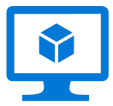

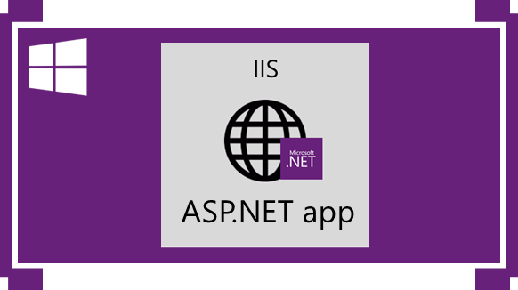
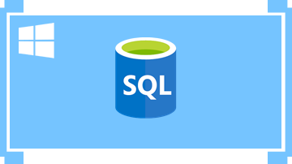

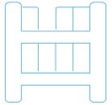
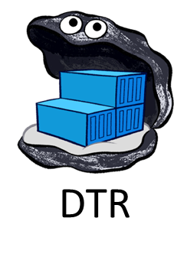

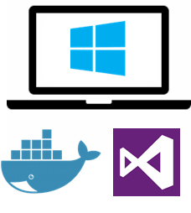

Using CI/CD pipelines to automate build and deploy for microservices/containers
5.
Deployment choices
2.
3.
4.
Application
code repo
(SCC)
Build, CI
CD, deploy
Azure Container Instances (ACI)
Azure VM
Windows Server 2016
Docker Engine
VSTS
VSTS
docker push
Azure App Service
(Preview for Windows Containers)
Code Push
Docker Hub
or
Azure Container Registry
Service Fabric
(Mesh or cluster)
Custom
Image
Docker registry
git push
Azure Container Service
KUBERNETES
Inner loop
1.
Code,
run,
debug
(*) SQL Server in a container should only be used for dev/test environments.
Move to high available systems, like Azure SQL Database, for production environments
Dev environment
Notes:
Include “ACR Build” when the Preview supports WINDOWS CONTAINERS.
As of //BUILD 2018 it only supports LINUX containers

Slide 12
Choosing orchestrators in Azure
Azure Product
Orchestrator / Engine | Description | Good for | Common workloads
 | Kubernetes is an open-source platform for automating deployment, scaling, and operations of application containers across clusters of hosts. AKS: You pay for VMs in cluster ACS Engine: IaaS container infrastructure |  | Microservices based on containers
 | Azure Service Fabric is a distributed systems platform that makes it easy to package, deploy, and manage scalable and reliable microservices. Mesh: PaaS/Serverless platform Cluster: You pay for VMs in cluster |  | Microservices based on containers Microservices based on plain processes Stateful services
Azure Kubernetes Service
(AKS)
Kubernetes
It’s an OSS ecosystem
More mature:
Less mature:
Azure Service Fabric
(Mesh and cluster)
Service Fabric
It’s a Microsoft ecosystem
and OSS
More mature:
Less mature:

